Slide 1
Malaria Cell Image Classification
Prepared by: Syeda Saiara Lubaba
ID: 1510876042

Slide 2
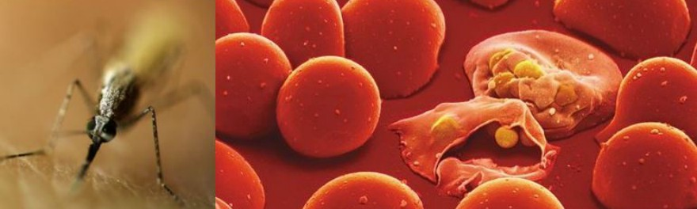
Overview
This project will detect whether an image of a human blood cell is malaria infected or not.

Slide 3
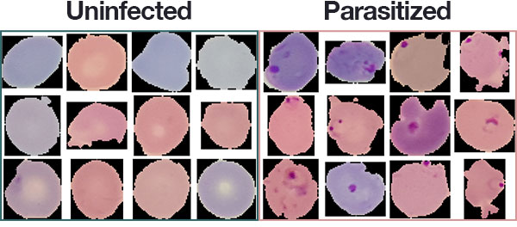
Dataset
The dataset of this project is collected from National Institute of Health (NIH) of USA.
Link: https://lhncbc.nlm.nih.gov/publication/pub9932
This dataset contains 27,558 cell images with an equal number of parasitized and uninfected cells.

Slide 4
Approach
Among the 27,558 cell images, with an equal number of parasites and unaffected cell, I have used 80% of the data for training.
I have used pre trained ResNet model architecture replicated by Adrian RoseBrock in his book, Deep Learning for Computer Vision with Python.
To train the model I have used Keras with Tensorflow Backend.
Optimizer: stochastic gradient descent.
Loss Function: Binary cross entropy loss.

Slide 6
Result
96.50% Accuracy on the training data
96.78% Accuracy on the validation data
96% Accuracy on the testing data

Slide 7
Thank you.

